Slide 1
Outline
String Matching
Introduction
Naïve Algorithm
Rabin-Karp Algorithm
String Matching using Finite Automata
Knuth-Morris-Pratt (KMP) Algorithm
Many more

Slide 2
Introduction
What is string matching?
  Finding all occurrences of a pattern in a given text (or body of text)
Many applications
  While using editor/word processor/browser
  Login name & password checking
  Virus detection
  Header analysis in data communications
  DNA sequence analysis, Web search engines (e.g. Google), image analysis

Slide 3
String-Matching Problem
A text is an array T [1..n] of length n
The pattern is an array P [1..m] of length m m<= n
Elements of T and P are characters from a finite alphabet ∑
  e.g., ∑ = {0,1} or ∑ = {a, b, …, z}
Usually T and P are called strings of characters

Slide 4
String-matching problem:
Finding all valid shifts for a given pair of T and P
…
If P occurs with a shift s in text T,
then s is a valid shift, otherwise s is an invalid shift
What is shift?
We say that the pattern P occurs with shift s in text T if:
  0 ≤ s ≤ n-m and
  T [(s+1)..(s+m)] = P [1..m]

Slide 5
Example 1: single occurrence of pattern P = “abaa” in the Text T
1
2
3
4
5
6
7
8
9
10
11
12
13
Text T
a | b | c | a | b | a | a | b | c | a | b | a | c
Shift s = 3
pattern P
a | b | a | a
1
2
3
4
Thus shift s = 3 is a valid shift
(here length of the text n=13,
Length of pattern m=4 therefore shifts s
0 ≤ s ≤ n-m )

Slide 6
Example 2 : multiple occurrences of the pattern in the Text
1
2
3
4
pattern P
a
b
a
a
1
2
3
4
5
6
7
8
9
10
11
12
13
Text T
a | b | c | a | b | a | a | b | c | a | b | a | a
First valid shift
s = 3
a | b | a | a
Second valid shift
S = 9
a
b
a
a

Slide 7
Terminology used
Concatenation of two strings x and y is xy
  E.g., x=“sri”, y=“lanka” ⇒ xy = “srilanka”
prefix A string w is a prefix of a string x, if x=wy for some string y
  e.g., “srilan” is a prefix of “srilanka”
suffix A string w is a suffix of a string x, if x=yw for some string y
  e.g., “anka” is a suffix of “srilanka”

Slide 8
Naïve String-Matching Algorithm
Input: Text strings T [1..n] and P[1..m]
Result: All valid shifts displayed
NAÏVE-STRING-MATCHER (T, P)
n ← length[T]
m ← length[P]
for s ← 0 to n-m
if P[1..m] = T [(s+1)..(s+m)]
print “pattern occurs with shift” s

Slide 9
Naïve Algorithm Forward
The Naïve algorithm consists in checking, at all the positions in the text between 0 to n-m, whether an occurrence of the pattern starts there or not.
After each attempt, it shifts the pattern by exactly one position to the right.
Example (from left to right):
a b c a b c a
a b c a (shift = 0)
a b c a (shift = 1)
a b c a (shift = 2)
a b c a (shift = 3)

Slide 10
Analysis: Worst-case Example
1
2
3
4
pattern P
a
a
a
b
1
2
3
4
5
6
7
8
9
10
11
12
13
text T
a | a | a | a | a | a | a | a | a | a | a | a | a
a
a
a
b
n = 13
m = 4
a
a
a
b
we need (n-m+1)m = (13-4+1)4 comparisons in total

Slide 11
Worst-case Analysis
For a Text of size n & Pattern of size m
There are m comparisons for each shift in the worst case
There are n-m+1 shifts including shift = 0
So, the worst-case running time is Θ((n-m+1)m)
    In the example on previous slide, we have (13-4+1)4 comparisons in total
Naïve method is inefficient because information from earlier shift is not used again

Slide 12
Analysis
Brute force pattern matching runs in time O(mn) in the worst case.
But most searches of ordinary text take
O(m+n), which is very quick.
continued

Slide 13
Brute-force Analysis (Best)
Best Case for finding a single pattern
  Example1: Found in first position of text
    Text: 0000000000000000001
    Pattern: 000
    Cost = O(m)
  Example2: Pattern Not found and always a mismatch on first character
    Text: 0000000000000000001
    Pattern: 11
    Cost = O(n + m)

Slide 14
Naïve Algorithm backward
Example (from right to left):
a b c a b c a
a b c a (shift =3)
a b c a (shift = 2)
a b c a (shift = 1)
a b c a (shift = 0)
Pattern occur with shift 0 and 3

Slide 15
Rabin-Karp Approach
We can view a string of k characters (digits) as a length- k decimal number
  e.g., the sub string “31425” may be treated as the decimal number 31,425
p: Given a pattern P [1..m], let p denote the corresponding decimal value of it
t_{s} Given a text T [1..n], let t_{s} denote the decimal value of the substring of length-m with shift s
T [(s+1)..(s+m)] for s=0,1,…,(n-m)

Slide 16
Rabin-Karp Approach …contd
t_{s} = p iff T [(s+1)..(s+m)] = P [1..m]
Thus s is a valid shift iff t_{s} = p
p can be computed in O(m) time
  p = P[m] + 10 (P[m-1] + 10 (P[m-2]+…))
t₀ can similarly be computed in O(m) time
Other t₁, t₂,…, t_{n-m} all can be computed in O(n-m) time since t_{s+1} can be computed from t_{s} in constant time
Here t_{s} denote the decimal value of the substring of the length-m
T [(s+1)..(s+m)] for s=0,1,…,(n-m)

Slide 17
t_{s} denote the decimal value of the length-m substring
T [(s+1)..(s+m)] for s=0,1,…,(n-m) t_{s+1} can be computed from t_{s} in constant time
t_{s+1} = 10(t_{s} - 10^{m-1} ·T [s+1]) + T [s+m+1](2new digit entering)
  E.g., if T={…,3,1,4,1,5,2,…}, m=5 and
  t_{s}= 31,415, then t_{s+1} = 10(31,415 – 10000·3) + 2
  =14152
  Thus we can compute p in Θ (m) and can compute
  t₀, t₁, t₂,…, t_{n-m} in Θ (n-m+1) time
  And we can find all occurrences of the pattern
  P[1…m] in text T[1…n] with Θ (m) preprocessing time and Θ (n-m+1) matching time.

Slide 18
But…a problem:
this is assuming that
p and t_{s} are small numbers
  They may be too large to work with easily

Slide 19
Rabin-Karp Algorithm
  Also works well in practice
Based on number-theoretic notion of modular equivalence
We assume that ∑ = {0,1, 2, …, 9}, i.e., each character is a decimal digit
  In general, use radix-d where d = |∑|

Slide 20
Division Theorem
For an integer a and any positive integer n, unique integers q and r exist such that,
a = q · n + r where 0 ≤ r < n
e.g., 23 = 3 · 7 + 2, -19 = -3 · 7 + 2
q = ⎣a/n⎦, is the quotient of the division
r = a mod n, is the remainder of the division

Slide 21
Modular Equivalence
If (a mod n) = (b mod n), then we say
“a is equivalent to b, modulo n”
Denoted by a ≡ b (mod n)
That is, a ≡ b (mod n) if a and b have the same remainder when divided by n
  E.g., 23 ≡ 37 ≡ -19 (mod 7)

Slide 22
Modular Arithmetic
if we are working modulo n, every result x is replaced by one of {0,1,…,n-1} that is equivalent to x, modulo n
That is, x is replaced by “x mod n”
E.g., if we are working modulo 7, then each of 23, 37 replaced by 2
-19 will also be replaced by 2

Slide 23
t_{s+1} ≡ (10(t_{s} – T[s+1]h) + T [s+m+1]) (mod q)
  here h =10 ^{m-1} (mod q)
q is chosen as a small prime number ; e.g., 13 for radix 10
  Generally, if the radix is d, then dq should fit within one computer word

Slide 24
How values modulo 13 are computed
3
1
4
1
5
2
old high-order digit
new low-order digit
7
8
14152 ≡ ((31415 – 3 · 10000) · 10 + 2 )(mod 13)
≡ ((7 – 3 · 3) · 10 + 2 )(mod 13)
≡ 8 (mod 13)

Slide 25
Problem of Spurious Hits
t_{s} ≡ p (mod q) does not imply that t_{s}=p
  Modular equivalence does not necessarily mean that two integers are equal
A case in which t_{s} ≡ p (mod q) when t_{s} ≠ p is called a spurious hit
On the other hand, if two integers are not modular equivalent, then they cannot be equal

Slide 26
Example- spurious hits
3
1
4
1
5
pattern
mod 13
text
7
1
2
3
4
5
6
7
8
9
10
11
12
13
14
2
3
1
4
1
5
2
6
7
3
9
9
2
1
mod 13
1
7
8
4
5
10
11
7
9
11
valid match
spurious hit

Slide 27
Rabin-Karp Algorithm
Basic structure like the naïve algorithm, but uses modular arithmetic as described
For each hit, i.e., for each s where t_{s} ≡ p (mod q), verify character by character to confirm whether s is a valid shift or a spurious hit
In the worst case, every shift may be required to be verified
  Running time can be shown as O((n-m+1)m)
Average-case running time is O(n+m)

Slide 28
Example 2
Let T = a b c b a b and P = a b c
Take a = 97, b = 98, c= 99 (i.e. ASCII value of characters).
|∑ |= 256.
Integer value of P, p = c + 256×(b+256× a)
= [99 + 256×(98+256× 97)] % 256
=197
In similar fashion, we can calculate hash value of m-length texts and compare to check valid / spurious hit (as in previous slides).
Analysis
In the worst case, every shift may br required to be verified
  Running time can be shown as O((n-m+1)m)
Average-case running time is O (n + m)

Slide 29
Question 1
How many comparisons (both successful and unsuccessful) will be made by the brute-force algorithm in searching for each of the following patterns in the binary text of one thousand zeros?
a. 00001 b. 10000 c. 01010

Slide 30
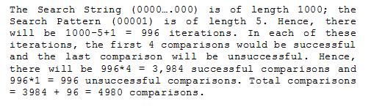
(a)

Slide 31
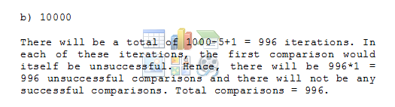

Slide 32
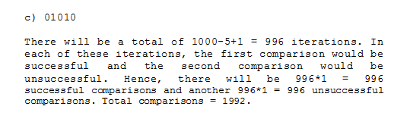

Slide 33
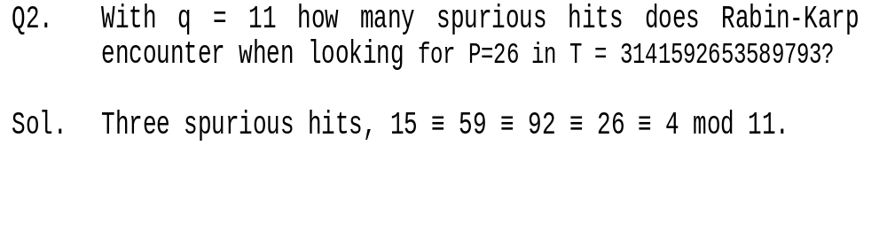

Slide 34
Finite Automata
A finite automaton M is a 5-tuple (Q, ∑, δ q_{0,} F ), where
  Q is a finite set of states
  q₀ ε Q is the start state
  F ⊆ Q is a set of accepting states
  ∑ is a finite input alphabet
  δ is the transition function that gives the next state for a given current state and input

Slide 35
How a Finite Automaton Works
The finite automaton M begins in state q₀
reads characters from ∑ one at a time
If M is in state q and reads input character a, M then it moves to state δ(q,a)
If its current state q is in F, M is said to have accepted the string read so far
An input string that is not accepted is said to be rejected

Slide 36
Example
Q = {0,1}, q₀ = 0, F={1}, ∑ = {a, b}
δ(q, a) shown in the transition table/diagram
This accepts a string that ends in an odd number of a’s; e.g., abbaaa is accepted while aa is rejected
input
a
state
a
b
0
1
0
0
1
b
1
0
0
a
transition table
Final state
transition diagram
b

Slide 37
String-Matching Automata
Given the pattern P [1..m], build a finite automaton M
  The state set is Q={0, 1, 2, …, m}
  The start state is 0
  The only accepting state is m
Time to build M can be large if ∑ is large

Slide 38
String-Matching Automata …contd
Scan the text string T [1..n] to find all occurrences of the pattern P [1..m]
String matching is efficient: Θ(n)
  Each character is examined exactly once
  Constant time for each character
But …time to compute δ is O(m |∑|)
  as δ has O(m |∑| ) entries

Slide 39
String-Matching Automata
In order to construct a string matching automata corresponding to a given pattern, we define auxiliary function (suffix function) σ
σ: Σ*→{0, 1, 2,...m} such that σ(x) is the length of the longest prefix of P that is suffix of x.
For example, for P=a b, σ(c c a c a)=1, σ(a b) = 2, σ(ε)=0
For a pattern P of length m, we have σ(x)=m if and only if P is suffix of x.

Slide 40
String-Matching Automata
Given the pattern P [1..m], build a finite automaton M
  The state set is Q={0, 1, 2, …, m}
  The start state is 0
  The only accepting state is m
  δ(q, a) = σ(P_{q} a), where P_{i} means pattern P₁.....P_{i}

Slide 41
Consider the pattern P = a b a b a c a
Transition on state 0:
δ(0, a)= σ(P₀ a)= σ(εa)= σ(a)= 1, [length of longest prefix of P that is suffix of a]
δ(0, b)= σ(P₀ b)= σ(ε b)= σ(b)= 0,
δ(0, c)= σ(P₀ c)= σ(ε c)= σ(c)= 0
Transition on state 1:
δ(1, a)= σ(P₁ a)= σ(a a)= 1,
δ(1, b)= σ(P₁ b)= σ(a b)= 2
δ(1, c)= σ(P₁ c)= σ(a c)= 0

Slide 42
For the pattern P = a b a b a c a
Transition on state 2:
δ(2, a)= σ(P₂ a)= σ(a b a)= 3,
δ(2, b)= σ(P₂ b)= σ(a b b)= 0
δ(2, c)= σ(P₂ c)= σ(a b c)= 0
Transition on state 3:
δ(3, a)= σ(P₃ a)= σ(a b a a) = 1
δ(3, b)= σ(P₃ b)= σ(a b a b)= 4
δ(3, c)= σ(P₃ c)= σ(a b a c)= 0

Slide 43
for the pattern P = a b a b a c a
Transition on state 4:
δ(4, a)= σ(P₄ a)= σ(a b a b a)= 5
δ(4, b)= σ(P₄ b)= σ(a b a b b)= 0
δ(4, c)= σ(P₄ c)= σ(a b a b c)= 0
Transition on state 5:
δ(5, a)= σ(P₅ a)= σ(a b a b a a)= 1,
δ(5, b)= σ(P₅ b)= σ(a b a b a b)= 4
δ(5, c)= σ(P₅ c)= σ(a b a b a c)= 6

Slide 44
for the pattern P = a b a b a c a
Transition on state 6:
δ(6, a)= σ(P₆ a)= σ(a b a b a c a) = 7
δ(6, b)= σ(P₆ b)= σ(a b a b a c b)= 0
δ(6, c)= σ(P₆ c)= σ(a b a b a c c)= 0
Transition on state 7:
δ(7, a)= σ(P₇ a)= σ(a b a b a c a a)= 1
δ(7, b)= σ(P₇ b)= σ(a b a b a c a a b)= 2
δ(7, c)= σ(P₇ c)= σ(a b a b a c a a c)= 0

Slide 45
Algorithm
Input: Text string T [1..n], δ and m
Result: All valid shifts displayed
FINITE-AUTOMATON-MATCHER (T, m, δ)
n ← length[T]
q ← 0
for i ← 1 to n
q ← δ (q, T [i])
if q = m
print “pattern occurs with shift” i-m

Slide 46
input a b a b a b a c a b a
Φ(Ti) 0 1 2 3 4 5 4 5 6 7 2 3
a
a
b
a
Start state
a
b
a
c
a
b
a
5
6
7
Final state
0
1
2
3
4
b
State | a | b | c | pattern
0 | 1 | 0 | 0 | a
1 | 1 | 2 | 0 | b
2 | 3 | 0 | 0 | a
3 | 1 | 4 | 0 | b
4 | 5 | 0 | 0 | a
5 | 1 | 4 | 6 | c
6 | 7 | 0 | 0 | a
7 | 1 | 2 | 0

Slide 47
3. The Boyer-Moore Algorithm
The Boyer-Moore pattern matching algorithm is based on two techniques.
1. The looking-glass technique
  find P in T by moving backwards through P, starting at its end of P

Slide 48
2. The character-jump technique
  when a mismatch occurs at T[i] == x
  the character in pattern P[j] is not the
  same as T[i]
There are 3 possible
cases, tried in order.
T
x
a
i
P
b
a
j

Slide 49
Case 1
If P contains x somewhere, then try to
shift P right to align the last occurrence
of x in P with T[i].
T
T
?
x
a
x
a
?
i
i_{new}
and
move i and
j right, so
j at end
P
P
x
c
b
a
x
c
b
a
j
j_{new}

Slide 50
Case 2
If P contains x somewhere, but a shift right to the last occurrence is not possible, then
shift P right by 1 character to T[i+1].
T
T
?
x
a
x
x
a
x
i
i_{new}
and
move i and
j right, so
j at end
P
P
c
w
a
x
c
w
a
x
j
j_{new}
x is after
j position

Slide 51
Case 3
If cases 1 and 2 do not apply, then shift P to align P[0] with T[i+1].
T
T
x
a
x
a
?
?
?
i
i_{new}
and
move i and
j right, so
j at end
P
P
d
c
b
a
d
c
b
a
j
0
j_{new}
No x in P

Slide 52
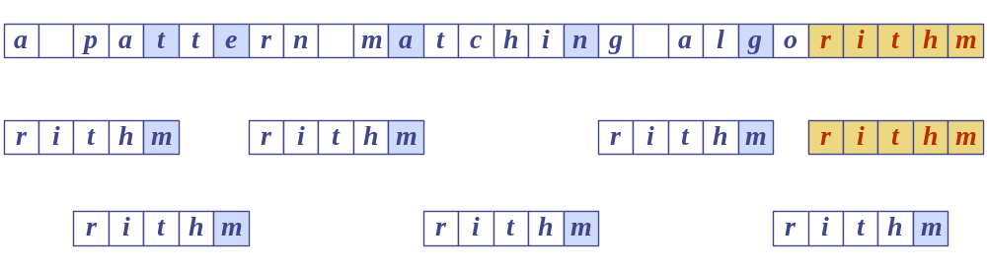
Boyer-Moore Example (1)
T:
P:

Slide 53
Last Occurrence Function
Boyer-Moore’s algorithm preprocesses the pattern P and the alphabet A to build a last occurrence function L()
  L() maps all the letters in A to integers
L(x) is defined as: // x is a letter in A
  the largest index i such that P[i] == x, or
  -1 if no such index exists

Slide 54
L() Example
P
a
b
a
c
a
b
0
1
2
3
4
5
A = {a, b, c, d}
P: "abacab"
x
a
b
c
d
L(x)
4
5
3
-1
L() stores indexes into P[]

Slide 55
Note
In Boyer-Moore code, L() is calculated when the pattern P is read in.
Usually L() is stored as an array
  something like the table in the previous slide

Slide 56
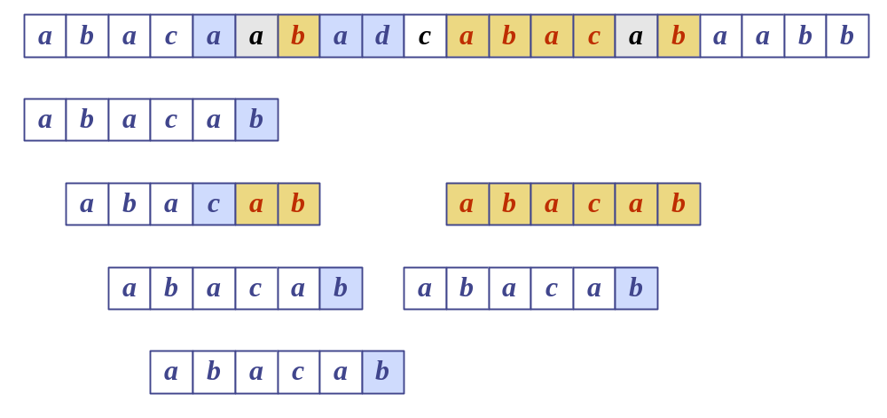
Boyer-Moore Example (2)
T:
P:
x
a
b
c
d
L(x)
4
5
3
−1

Slide 57
Analysis
Boyer-Moore worst case running time is
O(nm + A)
But, Boyer-Moore is fast when the alphabet (A) is large, slow when the alphabet is small.
  e.g. good for English text, poor for binary
Boyer-Moore is significantly faster than brute force for searching English text.

Slide 58
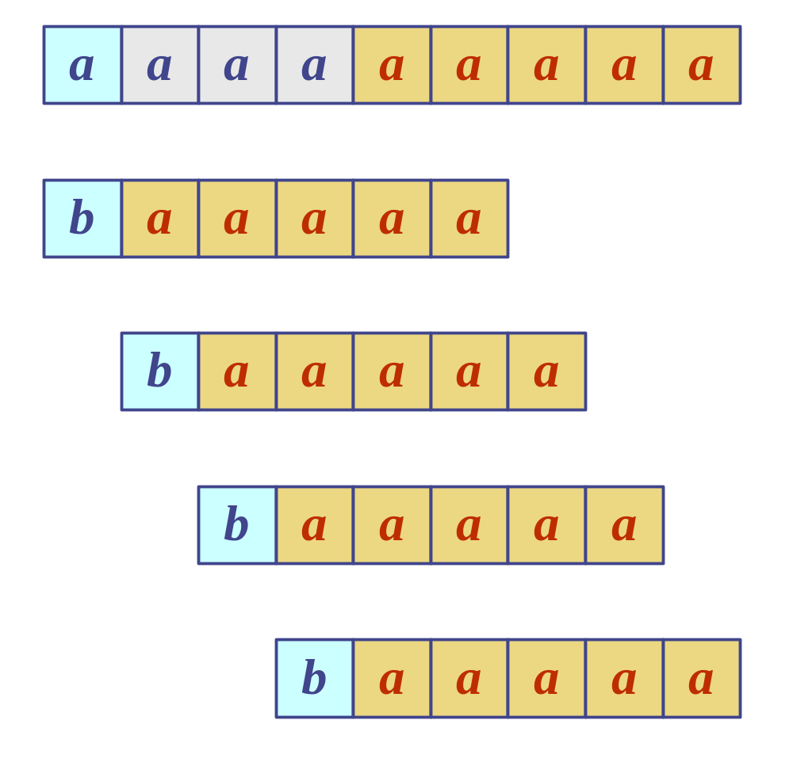
Worst Case Example
T:
T: "aaaaa…a"
P: "baaaaa"
P:

Slide 59
4. The KMP Algorithm
The Knuth-Morris-Pratt (KMP) algorithm looks for the pattern in the text in a left-to-right order (like the brute force algorithm).
But it shifts the pattern more intelligently than the brute force algorithm.
While in Finite automata :σ: Σ*→{0, 1, 2,...m} such that σ(x) is the length of the longest prefix of P that is suffix of x.
continued

Slide 60
In Finite automata :σ: Σ*→{0, 1, 2,...m} such that σ(x) is the length of the longest prefix of P that is suffix of x.
If a mismatch occurs between the text and pattern P at P[j], what is the most we can shift the pattern to avoid wasteful comparisons?
Answer: the largest prefix of P[0 .. j-1] that is a suffix of P[1 .. j-1]

Slide 61
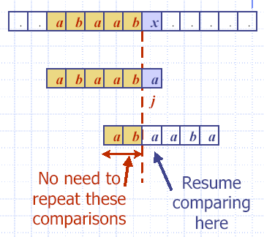
Example
T:
P:
j = 5
j_{new} = 2

Slide 62
Why
j == 5
Find largest prefix (start) of:
"a b a a b" ( P[0..j-1] )
which is suffix (end) of:
"b a a b" ( p[1 .. j-1] )
Answer: "a b"
Set j = 2 // the new j value

Slide 63
KMP Failure Function
KMP preprocesses the pattern to find matches of prefixes of the pattern with the pattern itself.
j = mismatch position in P[]
k = position before the mismatch (k = j-1).
The failure function F(k) is defined as the size of the largest prefix of P[0..k] that is also a suffix of P[1..k].

Slide 64
Failure Function Example
(k == j-1)
P: "a b a a b a"
j: 0 1 2 3 4 5
In code, F() is represented by an array, like the table.
k
0
1
2
3
4
F(k)
0
0
1
1
2
F(k) is the size of
the largest prefix which is
suffix also in P[1..k]

Slide 65
Why is F(4) == 2?
P: "abaaba"
F(4) means
  find the size of the largest prefix of P[0..4] that is also a suffix of P[1..4]
  = find the size largest prefix of "abaab" that
  is also a suffix of "baab"
  = find the size of "ab"
  = 2

Slide 66
Using the Failure Function
Knuth-Morris-Pratt’s algorithm modifies the brute-force algorithm.
  if a mismatch occurs at P[j]
  (i.e. P[j] != T[i]), then
  k = j-1;
  j = F(k); // obtain the new j to start comparison

Slide 67
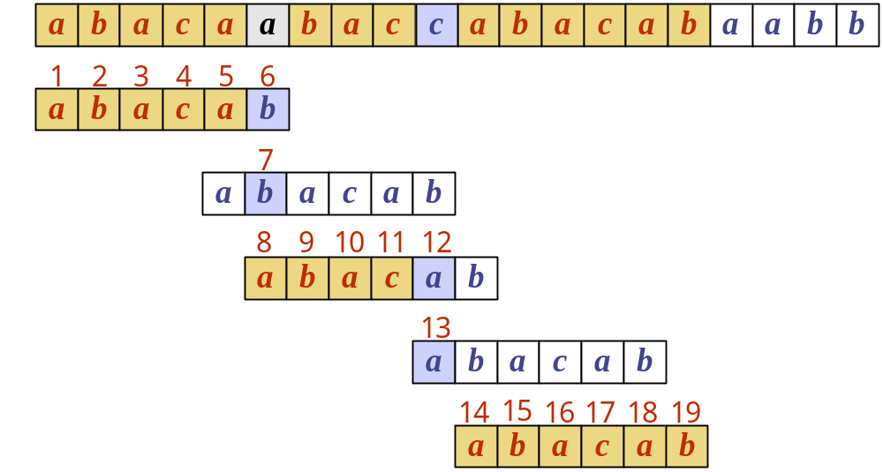
Example
T:
P:
k
0
1
2
3
4
F(k)
0
0
1
0
1

Slide 68
Why is F(4) == 1?
P: "abacab"
F(4) means
  find the size of the largest prefix of P[0..4] that is also a suffix of P[1..4]
  = find the size largest prefix of "abaca" that
  is also a suffix of "baca"
  = find the size of "a"
  = 1

Slide 69
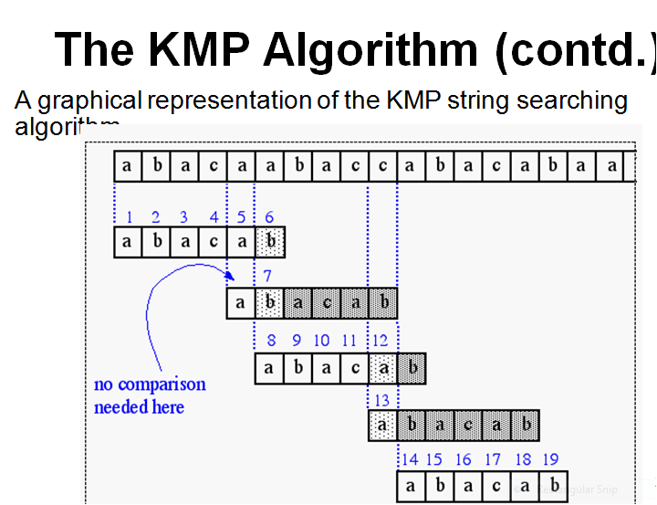

Slide 70
KMP Advantages
KMP runs in optimal time: O(m+n)
  very fast
The algorithm never needs to move backwards in the input text, T
  this makes the algorithm good for processing very large files that are read in from external devices or through a network stream

Slide 71
KMP Disadvantages
KMP doesn’t work so well as the size of the alphabet increases
  more chance of a mismatch (more possible mismatches)
  mismatches tend to occur early in the pattern, but KMP is faster when the mismatches occur later

Slide 72
Question 2
a. Give a regular expression for the set of strings over the alphabet {a, b} ending with aba.
b. Show a graphical representation of that automaton.
c. Indicate how this automaton can be used to find in a text the occurrences of string aba.

Slide 73
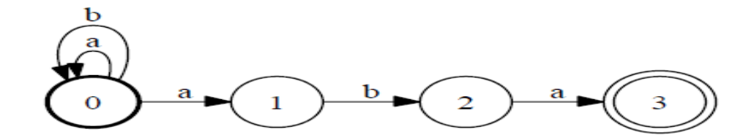
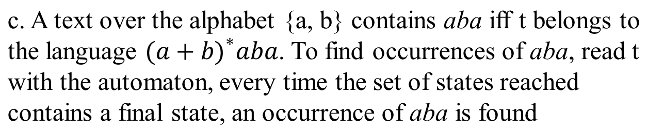
a. r = 〖(a+b)〗* aba

Slide 74
Question 3

